Slide 1
Depression Detection Using Tweets
UE20CS302 – Machine Intelligence
Mini Project
Project Title: Depression detection using tweets
Project Guide : Prof. Likitha P
Project Team with SRNs: Medha Koppam - PES1UG20CS251
Paladugula Lakshmi Snigdha - PES1UG20CS274
Prarthana P Rajapurohit – PES1UG20CS299

Slide 2
Problem Statement
Given how hectic modern civilization has made life, people are more susceptible to mental illnesses like despair and anxiety. Many elements of a human's life might be impacted by depression. The past ten years have seen a surge in research on the challenging issues of depression detection and prevention. Depression may result from the tensions, job schedules, and other factors that affect daily living. Researchers refer to depression as a form of mental cancer. Loss of interest in activities, suicidal thoughts, a sense of worthlessness or hopelessness, and a worsened capacity for thought and concentration are some of the emotions that might develop as a result of depression.
This project aims to apply natural language processing on Twitter feeds for conducting emotion analysis focusing on depression. Individual tweets are classified as positive or negative, based on a curated word-list to detect depression tendencies
Notes:
Provide a basic introduction of the project and also an overview of scope it entails.
Set the context.

Slide 3
Application and Uses
When making a clinical diagnosis, psychologists frequently conduct in-person interviews while using the Diagnostic and Statistical Manual of Mental Disorders criteria, which defines nine types of depressive symptoms.
Problem: Effectiveness yet lack of initiative. More than 70% of those who are depressed in its early phases would avoid seeing a psychologist.
Researchers are starting to utilize Twitter as a tool to investigate public health issues since it has 230 million regular users and has developed into such a broad stream of personal expression.
This experiment seeks to identify depression by using sentiment analysis on a sample of random tweets. The assignment is to categorize tweets into two types: normal and depressive, with depressive tweets being those that contain keywords associated with depression.
The various models proposed in the project can be used to create applications (adding a frontend) that could take user tweets as inputs and add-on a classification model that identifies if the person is depressed or not
Notes:
Provide a basic introduction of the project and also an overview of scope it entails.
Set the context.

Slide 4
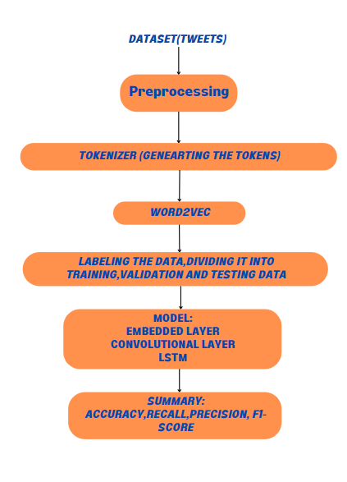
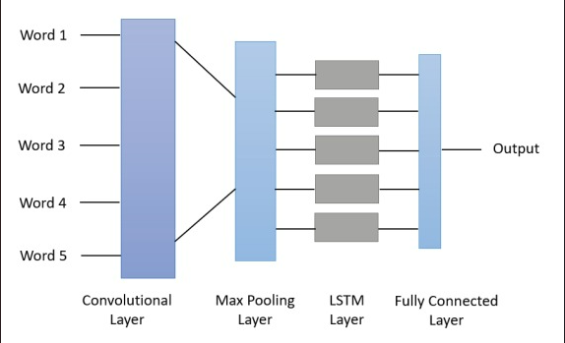
High level Architecture
The tweets are categorized in this project using a CNN+LSTM model technique, and the results are displayed using several metrics like accuracy, precision, recall, and confusion matrix.
Notes:
Provide a basic introduction of the project and also an overview of scope it entails.
Set the context.

Slide 5
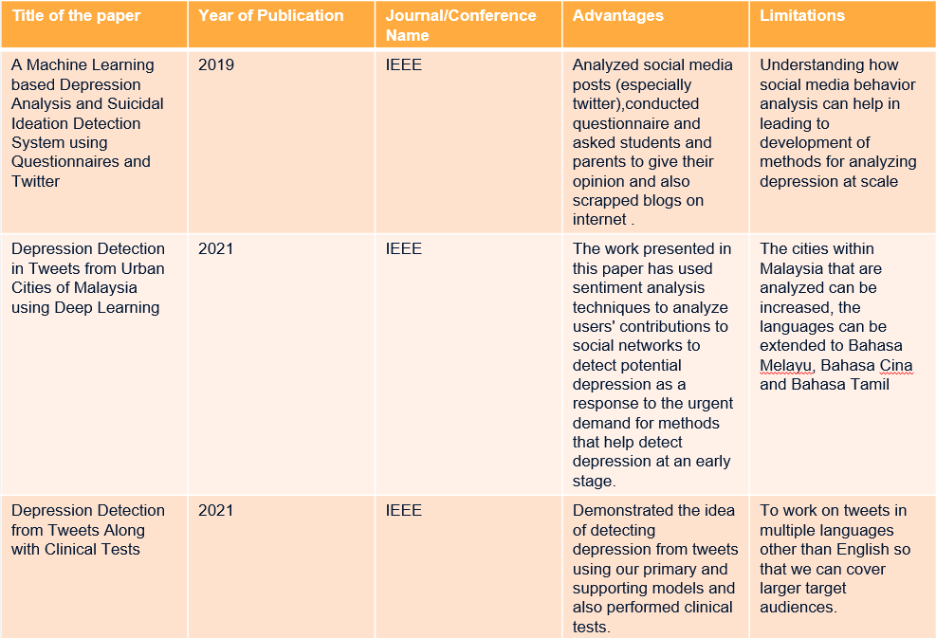
Literature Survey

Slide 6
Literature Survey
Title of the paper | Year of Publication | Journal/Conference Name | Advantages | Limitations
Depression Analysis from Social Media Data in Bangla Language using Long Short Term Memory (LSTM) Recurrent Neural Network Technique | 2019 | IEEE | Low learning rate of the model, avoids overshooting problem. LSTM Deep Recurrent Network provided high accuracy for a stratified dataset | Smaller dataset due to constraint of only Bangla Language
Depression Detection in Twitter Tweets using Machine Learning Classifiers | 2022 | IEEE | Depression detection without specific keywords, given the frequency of depression, its impact and logical feasibility | Can be implemented with only English language with low precision on CNN
Early detection of depression from social media data using machine learning algorithms | 2020 | IEEE | 1. Detect the early chances of a subject to suffer from depression 2. Find the machine learning algorithm which provides the maximum accuracy | The quality and the size of the dataset both are compromised and this results in work based on a small quantity of dataset.
Notes:
Provide summary of Phase – 1.
Include the suggestions and improvements made.

Slide 7
Literature Survey
Title of the paper | Year of Publication | Journal/Conference Name | Advantages | Limitations
Data-driven Depression Detection System for Textual Data on Twitter using Deep Learning | 2022 | IEEE | Different Models that had an accuracy of above 90%. | Model could be further used for tweets having languages other than English, containing images and other behavioural data.
Depression Detection on Social Media Using Text Mining | 2022 | IEEE | Uses a bag of words technique to discover the most regularly used terms among depressed people. | Learn more about how users' personalities influence the onset of major depressive illness in the future.
Depression Analysis of Social Media Activists Using the Gated Architecture Bi-LSTM | 2021 | IEEE | Uses a Bi-LSTM. Using bidirectional will run your inputs in two ways, one from past to future and one from future to past giving better results | Develop an application that shall let a user predict his depression index.
Notes:
Provide summary of Phase – 1.
Include the suggestions and improvements made.

Slide 8
Proposed Approach
Two datasets, 1 with tweets that indicate depression and the other containing random tweets that do not necessarily indicate depression. The google news vectors file contains the pretrained vectors for word2vec model
Due to the lack of publicly available dataset for depressive tweets, the essential dataset for this research was compiled by the web scraper TWINT, which used the keyword depression to collect all tweets from a given day.
The initial steps include preprocessing the data in order to expand contractions, remove emojis, hashtags, @mentions, and stop words of NLP. After which Tokens are generated.
Word2Vec is used to group together similar words. The KeyedVectors function from genesim is used and the googlenews pretrained vectors are sent in as arguments.
A CNN+LSTM model was used. In order to determine the optimal fit, various activation functions such as sigmoid, tanh, and softmax were utilized in the hidden layers. Given that logistic regression models provide good accuracy for binary classifications, the models' accuracy is compared to that of the LRM, and the model with the highest accuracy is ultimately picked. The ReLU function, which is implemented by the majority of CNNs in their activation layer, has been applied to all models. The various models explore the various optimizers and loss functions before concluding on the top model with an accuracy of 99.613%.
The results were compared with other models such as Naïve Bayes, SVC, logistic regression, SGD classifier. Though the accuracy of SVC and LSTM are same, LSTM is more reliable because of the optimization functions used and the z backpropagation that is carried out
Notes:
Provide summary of Phase – 1.
Include the suggestions and improvements made.

Slide 9
Results and Discussion
Model 1:
TF-IDF SVC (baseline model)
Accuracy: 99.613%
Model 2:
Naïve Bayes
Accuracy: 91.07%
Model 3:
SGD classifier
Accuracy: 98.51%
Loss function: Hinge
Model 5:
LSTM
Activation layer: ReLU
Hidden Layer: Sigmoid
Accuracy: 99.613%
Optimizer: adam
Loss function: Binary cross entropy
Model 4:
Logistic Regression Model
Activation function: Sigmoid
Accuracy: 96.87%
Dataset used: Sentiment140
It can be seen that the CNN + LSTM models using Relu + Sigmoid Activation functions gives us the best accuracy and reliability.
Notes:
Provide summary of Phase – 1.
Include the suggestions and improvements made.

Slide 10
References
1. S. Jain, S. P. Narayan, R. K. Dewang, U. Bhartiya, N. Meena and V. Kumar, "A Machine Learning based Depression Analysis and Suicidal Ideation Detection System using Questionnaires and Twitter," 2019 IEEE Students Conference on Engineering and Systems (SCES), 2019, pp. 1-6, doi: 10.1109/SCES46477.2019.8977211.
2. E. K. Priya Sri, K. S. Savita and M. Zaffar, "Depression Detection in Tweets from Urban Cities of Malaysia using Deep Learning," 2021 7th International Conference on Research and Innovation in Information Systems (ICRIIS), 2021, pp. 1-6, doi: 10.1109/ICRIIS53035.2021.9617079.
3. S. Maniar, K. Patil, B. Rao and R. Shankarmani, "Depression Detection from Tweets Along with Clinical Tests," 2021 International Conference on Intelligent Technologies (CONIT), 2021, pp. 1-6, doi: 10.1109/CONIT51480.2021.9498486.
4. S. Dessai and S. S. Usgaonkar, "Depression Detection on Social Media Using Text Mining," 2022 3rd International Conference for Emerging Technology (INCET), 2022, pp. 1-4, doi: 10.1109/INCET54531.2022.9824931.
5. M. Hasan and S. Ghane, "Data-driven Depression Detection System for Textual Data on Twitter using Deep Learning," 2022 2nd Asian Conference on Innovation in Technology (ASIANCON), 2022, pp. 1-5, doi: 10.1109/ASIANCON55314.2022.9909260.
6. M. R. Khan, S. Z. Rizvi, A. Yasin and M. Ali, "Depression Analysis of Social Media Activists Using the Gated Architecture Bi-LSTM," 2021 International Conference on Cyber Warfare and Security (ICCWS), 2021, pp. 76-81, doi: 10.1109/ICCWS53234.2021.9703014.
7. A. H. Uddin, D. Bapery and A. S. M. Arif, "Depression Analysis from Social Media Data in Bangla Language using Long Short Term Memory (LSTM) Recurrent Neural Network Technique," 2019 International Conference on Computer, Communication, Chemical, Materials and Electronic Engineering (IC4ME2), 2019, pp. 1-4, doi: 10.1109/IC4ME247184.2019.9036528.
8. S. K. Kumar, N. Dinesh and N. L, "Depression Detection in Twitter Tweets Using Machine Learning Classifiers," 2022 Second International Conference on Interdisciplinary Cyber Physical Systems (ICPS), 2022, pp. 81-86, doiICPS55917.2022.00023.
9. G. Geetha, G. Saranya, K. Chakrapani, J. G. Ponsam, M. Safa and S. Karpagaselvi, "Early Detection of Depression from Social Media Data Using Machine Learning Algorithms," 2020 International Conference on Power, Energy, Control and Transmission Systems (ICPECTS), 2020, pp. 1-6, doi: 10.1109/ICPECTS49113.2020.9336974.
Notes:
Provide summary of Phase – 1.
Include the suggestions and improvements made.

Slide 11
Thank You

